Slide 1
Optimizing compiler. Loop optimizations.

Slide 2
Source files
FE (C++/C or Fortran)
Internal representation
Two pass and single pass compilation scheme
Temporary files or
object files with
IR
Profiler
Scalar optimizations
Loop optimizations
Interprocedural optimizations
-Qipo/-Qip
Code generation
Scalar optimizations
Code generation
Object files
Loop optimizations
Executable file of
library
Notes:
Начнем разговор о архитектуре компилятора с разговора о FE и о внутреннем представлении компилируемой программы.

Slide 3
Loops
In most of the cases, the loops are 'hot spots' of the program.
That's why microprocessor architects and compiler developers pay high attention to the loops.
For example, Loop Stream Detector eliminates the sampling and decoding of instructions for the small loops. This is the hardware solution for improving loop performance.
In a compiler, there are many optimizations provided specially for the loop processing.

Slide 4
Loop recognition and classification.
Loop optimizations usually can be performed only for loops with a certain number of iterations and sequentially changing iteration variables. There should no be transitions outside of the loop and calls to unknown functions.
“Good” loops:
1.) for(i=0;i<U;i++) 3.) for(i=0;i<U;i++) {
a[i]=b[i]; a[j]=b[i];
j+=c*i; }
2.) i=0; 4.) i=0;
do { do {
a[i]=b[i]; a[i]=b[i];
i++; } while(i<U); if(i++>=n) break;
while(1);
Notes:
В общем случае компилятор не информирует пользователя о том, распознал ли компилятор пользовательские циклы. Т.е. если программист использовал конструкции while или for, то с точки зрения компилятора это еще не значит, что в программе существуют циклы. ☺

Slide 5
“Bad” loops
1.) for(i=0;i<3*i-n;i++)
a[i]=i;
2.) for(i=0;i<n;i++) {
a[i]=i;
if(i<t) break; }
3.) for(i=0;i<n;i++) {
a[i]=i;
if(i==t) goto loop_skip; }
4.) for(i=0;i<n;i++) {
a[i]=i;
t=g(i); }
Consider the complexity of the used structures.
Avoid loops with an uncertain number of iterations.
Notes:
При написании программы нужно учитывать, что циклы не всегда могут быть распознаны компилятором.

Slide 6
Loop Optimizations
Loop invariant code motion is an optimization, which finds and brings outside of the loop expressions, independent of the loop index variables. Such expressions are constant on each iteration.
while (j <maximum - 1) { j = j + (4 + array [k]) * pi +5; }
Loop invariant code motion
int t0 = maximum - 1; int t1 = (4 + array [k]) * pi +5; while (j <maxval) { j = j + calcval; }
Notes:
Some extension of Common Subexpression Elimination

Slide 7
Loop unswitching is an optimization which takes invariant conditional jump out of the loop body by duplicating its code.
do i=1,1000
x[i] = x[i] + y[i];
if (w) then y[i] = 0;
end do;
Loop unswitching
if (w) then
do i=1,1000
x[i] = x[i] + y[i];
y[i] = 0;
end do;
else
do i=1,1000 do
x[i] = x[i] + y[i];
end do
end if;

Slide 8
Some example estimation for loop unswitching effectiveness:
int main() {
float x[1000],y[1000];
int i,repeat,p;
for(i=0;i<1000;i++) { y[i] = i; x[i] = 1; }
for(repeat=0;repeat<3000000;repeat++) {
p=repeat%10>5;
#ifdef PERF
if(p) {
for(i=0;i<1000;i++) {
x[i]=x[i]+y[i];
y[i]++; }
}
else {
for(i=0;i<1000;i++) {
x[i]=x[i]+y[i]; }
}
#else
for(i=0;i<1000;i++) {
x[i]=x[i]+y[i];
if(p) {
y[i]++; } }
#endif
}
printf("x[123]= %f\n",x[123]);
}
icl –Od test.c –Fetest.exe
icl –Od test.c –DPERF –Fetest_opt.exe
x[123]= 1799937064960.000000
CPU time for command: 'test1.exe'
real 11.703 sec
user 11.672 sec
system 0.000 sec
x[123]= 1799937064960.000000
CPU time for command: 'test_opt.exe'
real 10.563 sec
user 10.328 sec
system 0.000 sec
Intel compiler makes loop unswitching with –O3
icl -O3 test1.c -debug:minimal -Fetest_opt1.exe
x[123]= 1799937064960.000000
CPU time for command: 'test_opt1.exe'
real 0.688 sec
user 0.656 sec
system 0.016 sec

Slide 9
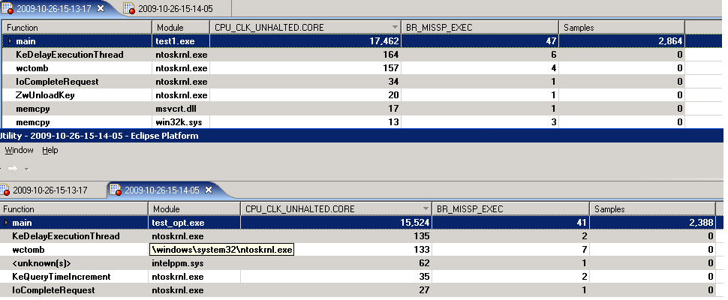
Comparison of branch missprediction events for original and modified tests

Slide 10
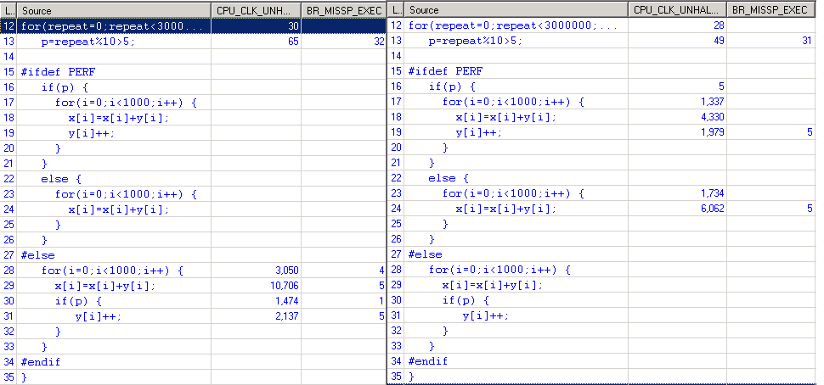
Binding processor events to lines of source code

Slide 11
Loop distribution and loop fusion are inverse optimizations. The compiler must have heuristics to estimate the profit of such optimizations. Loop distribution can increase performance by improving memory reference. It can be applied if a loop is working with many different arrays.
If there are a lot of different invariants inside the loop than loop distribution can improve register usage.
Loop distribution can be useful for auto parallelization or vectorization.
for (i = 0; i < n; i++) {
a[i] = F(i);
b[i] = G(I);
}
Loop distribution
for (i = 0; i < n; i++)
a[i] = F(i);
for (i = 0; i < n; i++)
b[i] = G(i);
Notes:
Разбиение/объединение циклов – это оптимизации которые необходимы при векторизации и параллелизации.

Slide 12
Loop fusion can be beneficial for small loops because of improving the instructional parallelism level and data reusability.
Different microprocessors have different criteria for profitability of this optimizations.
for (i = 0; i < n; i++)
a[i] = F(i);
for (i = 0; i < n; i++)
b[i] = G(i,a[i]);
Loop fusion
for (i = 0; i < n; i++) {
a[i] = F(i);
b[i] = G(i,a[i]);
}

Slide 13
Loop peeling (splitting) is an optimization, which tries to simplify the loop detaching the extreme iterations.
This optimization can be useful for loop fusion.
p = 10;
for (i=0; i<10; ++i) {
y[i] = x[i] + x[p];
p = i;
}
Loop peeling
y[0] = x[0] + x[10];
for (i=1; i<10; ++i) {
y[i] = x[i] + x[i-1];
}

Slide 14
Loop unrolling is an optimization designed to reduce the loop iteration number by merging several iterations. The goal of loop unrolling is to reduce loop control instructions and branch penalties. This optimization can improve instruction parallelism and reusability of data. Main disadvantage of this optimization is code expansion.
for (int x = 0; x < 100; x++) {
delete(x);
}
Loop unrolling
for (int x = 0; x < 100; x += 5) {
delete(x);
delete(x+1);
delete(x+2);
delete(x+3);
delete(x+4);
}
Complete unrolling is applied to small loops and can be very effective. As a general rule in the case of nested loops, inner loops are unrolled.

Slide 15
Loop interchange is a loop optimization, which changes the order of iteration variables. The major purpose of loop interchange is to improve the cache performance for accessing array elements.
m
m
a
a
for(i=0;i<N;i++)
for(j=0;j<K;j++)
a[j][i]= F(I,j,..)
for(j=0;j<K;j++)
for(i=0;i<N;i++)
a[j][i]= F(I,j,..)
The cache line (64 bytes) is transmitted to the cache by data bus to access one element of the array
Cache-line provides access to several consecutive array elements

Slide 16
INTEGER,PARAMETER :: N=100
INTEGER,PARAMETER :: REPEAT=1000
INTEGER :: A(N,N,N), B(N,N,N)
INTEGER :: REP,I,J,K
A=1
B=1
DO REP=1,REPEAT
DO I=1,N
DO J=1,N
DO K=1,N
A(J,K,I) = A(J,K,I)+B(J,K,I)
END DO
END DO
END DO
END DO
PRINT *,A(1,1,1)
END
The example of the effectiveness of optimization of loop interchange.
:
ifort-O3 test.f90-o a.out ifort-O2 test.f90-o b.out Message issued by the compiler (with internal key) reports that in the first case, the compiler has made permutation cycles. ... LOOP INTERCHANGE in loops at line: 9 11 12 13 Loopnest permutation (1 2 3 4) -> (2 4 1 3) ... time. / a.out real 0m0.960s time. / b.out real 0m6.862s

Slide 17
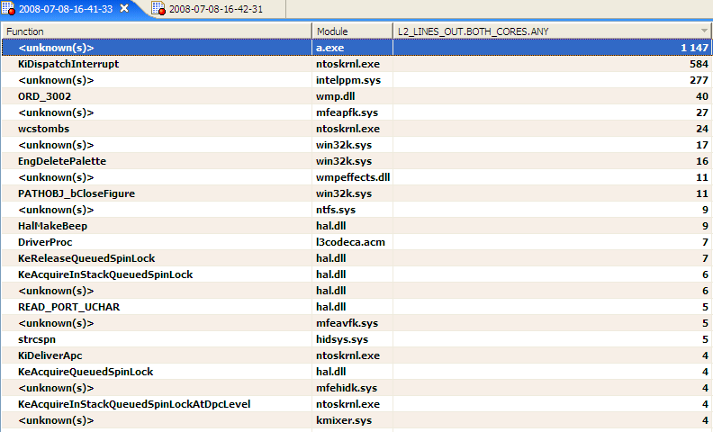

Slide 18
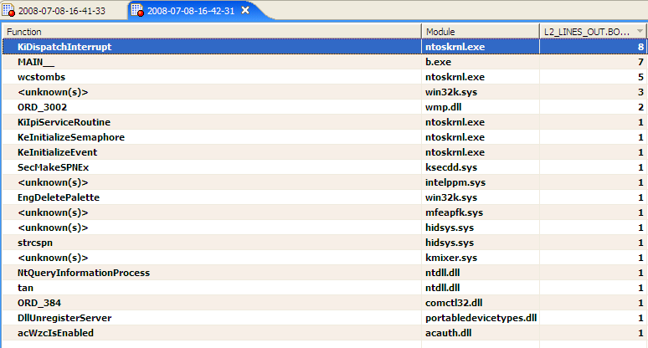

Slide 19
Loop blocking is a loop optimization which divides a loop iteration space into smaller chunks or blocks, so the loop data stays in the cache until it is reused. The partitioning of loop iteration space leads to partitioning the array used, so array elements fit the cache better, it enhancing cache reuse and decreasing required cache size.
for (int x = 0; x < n; x++) {
...
}
Loop blocking
for (int j = 0; j < n; j+=B) {
for (i=j; i<min(n,j+b); i++) {
...
}

Slide 20
INTEGER, PARAMETER :: N=2000
INTEGER :: BF,BN,I,J,K,I1,J1,K1
DOUBLE PRECISION, ALLOCATABLE :: A(:,:),B(:,:),C(:,:)
ALLOCATE(A(N,N),B(N,N),C(N,N))
A=1
B=-1
#ifdef PERF
BF=8
BN=N/BF
DO I1=1,BF
DO J1=1,BF
DO K1=1,BF
DO I=1+BN*(I1-1),MIN(BN*I1,N)
DO J=1+BN*(J1-1),MIN(BN*J1,N)
DO K=1+BN*(K1-1),MIN(BN*K1,N)
C(J,I) = C(J,I) + A(I,K)*B(K,J)
END DO
END DO
END DO
END DO
END DO
END DO
#else
DO I=1,N
DO J=1,N
DO K=1,N
C(J,I) = C(J,I) + A(I,K)*B(K,J)
END DO
END DO
END DO
#endif
PRINT *,C(1:100,700:800)
END
Loop blocking
ifort loop_blocking.F90 /fpp –Od -Feoriginal
ifort loop_blocking.F90 /fpp –DPERF –Od –Feblocking
Nehalem:
Time original.exe ~150s
Time blocking.exe ~105s

Slide 21
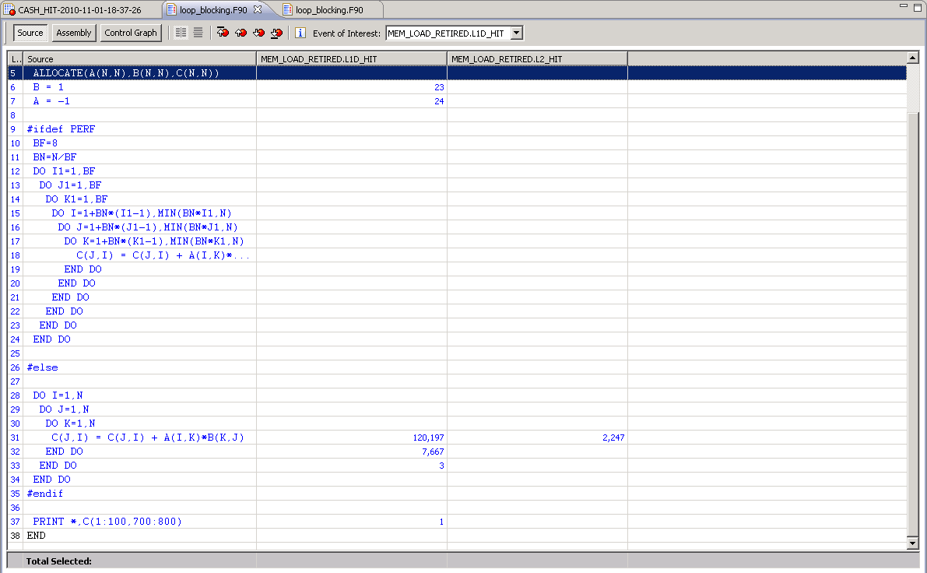

Slide 22
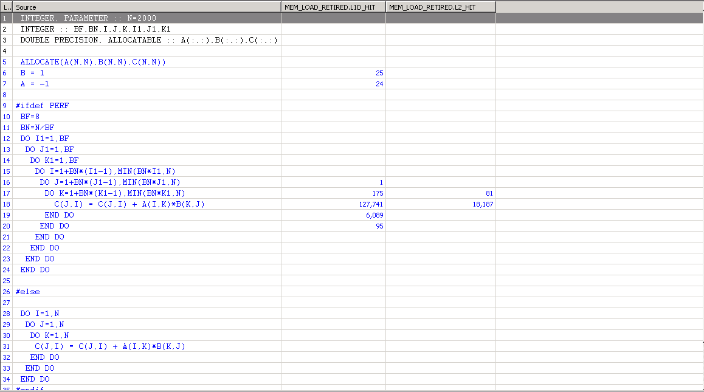

Slide 23
Strength reduction
Expressions, which are a linear function of the iteration counts can be calculated by adding the constant to the value at the previous iteration.
for(i=0;i<100;i++) {
a[i]=i*8+4;
}
Strength reduction
temp=4;
for(i=0;i<100;i++) {
a[i] = temp;
temp +=8;
}

Slide 24
In addition to these optimizations, there are other, sometimes very complex:
Scalar expansion
Loop coalescing
Loop collapsing and many others
The compiler in each case should prove the correctness of the optimization and determine its profit.

Slide 25
Dependence
The calculations are equivalent if they calculate the same data and output the same values ​in the same order.
​Each task can be calculated with different sequences of instructions (some of which may be more effective than the others) if they are equivalent. Optimization which change sequence of instructions is called permutational.
What features of the task instructions could cause wrong results because of instruction permutation?
Notes:
Мы рассмотрели примеры некоторых базовых цикловых оптимизаций. Чтобы понять область их применения обсудим зависимости и что подразумевается под допустимыми оптимизациями.

Slide 26
Dependence is a connection between the statement of the program. A couple of statements <S1,S2> are dependent, if S2 should be performed after S1 in order to maintain the same result. S1 PI = 3.14 S2 R = 5 S3 AREA = PI * R ** 2 <S1,S2,S3> Equivalent <S2,S1,S3>
So there are two dependencies. <S1,S3>, <S2,S3>
The concept of linear dependence in the code is simple, but to get real benefits from the changes we need to extend this concept for loops and arrays. DO I = 1, N S1 A (I) = B (I) + 1 S2 B (I +1) = A (I) - 5 END DO
There is a dependence <S2,S1> <S1,S2> for all iterations except the first.
These dependencies are an example of data dependences. S1 IF (T.NE.0) THEN S2 A = A / T S3 ENDIF This is an example of control dependence. S2 can not be evaluated before S1.

Slide 27
Definition:
There is a data dependence between statement S1 and S2 if and only if
both statements refer to the same area of ​​memory and at least one of them writes to memory
There is a possible way in the execution of the program from the statement S1 to S2.
Dependencies are classified as follows:
True dependence (flow dependence) S1 X = ... S2 ... = X Represented as S1δS2 (δ - delta)
Antidependence S1 ... = X S2 X = ... S1δ-S2
Output dependence S1 X = ... S2 X = ... S1δ0S2

Slide 28
Loops
Loop dependencies can be more complicated DO I = 1, N S1 A (I +1) = A (I) + B (I) END DO
S1 depends on itself at the previous iteration DO I = 1, N S1 A (I +2) = A (I) + B (I) END DO
Normalized loop is usually used for analysis. Such loop starts from 1 to N with step 1. Any loop can be normalized (converted to normalized form).

Slide 29
Nested loops
If we have a nested loop. Then the iteration vector I of some iteration is a vector of integers, each of which represents the value of the iteration variable for each loop in the nesting order. I = {i1, i2, ..., in}
There is a loop dependency between the statements S1 and S2 in the set of nested loops, if and only if:
there are two iteration vectors i and j for the set, such that i <j or i = j and a path from S1 to S2 in the loop exists;
approval for iteration i S1 and S2 to the approval of iteration j refer to the same memory area;
One of these statements writes to this memory.

Slide 30
Now our task is to link the equivalence of two computational processes (in our case, before and after compiler optimization) with the definition of dependence. All loop optimizations discussed earlier are permutational (reordering) transformations. These transformations change the order of the instructions.
The fundamental dependency theorem:
Each optimization which preserves the dependencies in the program (i.e. does not change the order of the dependent claims) produces equivalent calculation.
Accordingly, some transformation is valid in this program if it preserves all the dependencies in the program.

Slide 31
How to determine the dependences in the case of a single array?
Assume that we have a set of nested loops DO i1 = 1, N1 DO i2 = 1, N2 ... DO in = 1, Nn S1 A (f1 (i1, ..., in), ..., fm (i1, ..., in)) = A (g1 (i1, ..., in), ..., gm (i1, ..., in)) END DO ... END DO END DO
Dependence exists if and only if there are iteration vectors I and J, such that I <J and the following system of equations: fi (I) = gi (J)
can be solved
Example:
DO I = 1, N A (I +1) = A (I) + B END DO I +1 = I + x

Slide 32
Dependency evaluation is complicated computational task even for single array usage.
Optimizing compiler uses different methods for proving permissibility of different permutational optimizations. In case when loop contains a lot of different arrays and pointers, this task can be very hard. Estimation can be used instead of precise calculation.

Slide 33
Alias analysis
Alias analysis is a technique used to determine if a storage location may be accessed in more than one way. Two pointers are said to be aliased if they point to the same location.
In order to properly find the dependence in the program is important to remove any memory ambiguity. That is, to identify all objects that may overlap in memory.
Optimizing compiler uses all possible information for decision making:
features of the language
results of interprocedural analysis
Local Point To analysis, etc.
If there are objects which compiler can not prove to have different locations, then compiler needs to act conservatively and forbid permutation optimization.

Slide 34
File sub.c
int sub(int *a, float *b, int n) {
int i;
for(i=0;i<n;i++) {
a[i]=0;
}
for(i=0;i<n;i++){
b[i]=0.0;
}
}
File main.c
#include <stdio.h>
#include <stdlib.h>
extern void sub(int *a,float *b, int n);
int main(){
int *a;
float *b;
a=(int*)malloc(100*sizeof(int));
b=(float*)malloc(100*sizeof(int));
sub(a,b,100);
printf("%d;%f\n",a[0],b[0]);
}
Question: Is it possible make loop fusion for the loops in this case?
icc –O3 –c main.c
icc –O3 –c sub.c
icc main.obj sub.obj
Notes:
Здесь нужно учитывать то, что компилятор в общем случае без межпроцедурных оптимизаций работает с одной функцией. Он не имеет информации о том где и с какими параметрами функция вызывается в других модулях.

Slide 35
icc main.c 2.c –O3
2.c(3): (col. 1) remark: LOOP WAS VECTORIZED.
2.c(6): (col. 1) remark: LOOP WAS VECTORIZED.
icc main.c 2.c –O3 –ansi-alias
2.c(3): (col. 1) remark: FUSED LOOP WAS VECTORIZED.
What's the difference?
-[no-]ansi-alias enable/disable(DEFAULT) use of ANSI aliasing rules in optimizations; user asserts that the program adheres to these rules.
ANSI aliasing rules require that the pointers can refer only to the objects of the same or compatible type. This means in practice that the pointers of incompatible type can not address the same memory.
Using –anti-alias option at compile time allows compiler to perform more aggressive optimizations.

Slide 36
There are special attributes in C/C++ language to facilitate the work of the compiler with the alias analysis. Pointers can be declared as restrict. This attribute means that only a pointer or an expression based on this pointer can refer to memory which is related with this pointer. int sub (int * a, float * b, int n) => int sub (int * restrict a, float * restrict b, int n)
Fortran language has stronger rules for pointers. Although the language has pointers to arrays, but each array, which can be referenced through the pointer must be explicitly declared as TARGET. By default, function arguments can’t refer to the same location. These rules simplify alias analysis.
Notes:
Т.е. если при написании кода вы ставите задачу улучшения производительности, нужно понимать какие трудности стоят перед компилятором и пытаться передать дополнительную информацию, которую он сможет использовать при оптимизации кода.

Slide 37
Compiler contains special option to show the results of different optimizations
/Qopt-report[:n]
generate an optimization report to stderr
0 disable optimization report output
1 minimum report output
2 medium output (DEFAULT when enabled)
3 maximum report output
Example:
LOOP INTERCHANGE in loops at line: 8 9
Loopnest permutation ( 1 2 ) --> ( 2 1 )
Fusion loop partitions: (loop line numbers)
Fused Loops: ( 9 14 )
Notes:
Компилятор не ставит пользователя в известность, какие цикловые оптимизации и в каком порядке принимаются. Есть опция /Qopt-report, которая частично информирует пользователя о произведенных преобразованиях.

Slide 38
Thank you.

